Slide 1

GOKARAJU RANGARAJU INSTITUTE OF ENGINEERING AND TECHNOLOGY
Department of Computer Science and Engineering
MINI Project Review-3
SMART ATTENDANCE MANAGEMENT SYSTEM
D.USHA SREE
(Assistant Professor, Dept of CSE)
GV Harshith A SAHITH
- 20241A05E7
- 20241A05C4 20241A05D6
20241A05C1
21245A0516
B SHIVA KRISHNA - A GUNATEJA - K RAVI CHANDRA -

Slide 2
Department of Computer Science and Engineering
GOKARAJU RANGARAJU INSTITUTE OF ENGINEERING AND TECHNOLOGY
MINI Project Review-3
ABSTRACT
We proposed an automatic attendance system using machine learning techniques such as CNN algorithm. The face detection and recognition will automatically detect the students present in the class room and mark the attendance by recognizing the student. The image is captured through a camera during the class hours. When the lecturing is going on faces of student are detected, segmented and stored for verification using Convolutional Neural Networks (CNN). In this project, the Open CV based face recognition approach has been proposed. This model integrates a camera that captures an input image, an algorithm for detecting face from an input image, encoding and identifying the face, marking the attendance in a spreadsheet and converting it into PDF file. The training database is created by training the system with the faces of the authorized students. The cropped images are then stored as a database with respective

Slide 3
Algorithms used:
GOKARAJU RANGARAJU INSTITUTE OF ENGINEERING AND TECHNOLOGY
Department of Computer Science and Engineering
MINI Project Review -3
Convolutional Neural Network:
A Convolutional Neural Network (CNN) is a type of deep learning algorithm that is particularly well-suited for image recognition and processing tasks. It is made up of multiple layers, including convolutional layers, pooling layers, and fully connected layers.
The convolutional layers are the key component of a CNN, where filters are applied to the input image to extract features such as edges, textures, and shapes. The output of the convolutional layers is then passed through pooling layers, which are used to down-sample the feature maps, reducing the spatial dimensions while retaining the most important information.
The output of the pooling layers is then passed through one or more fully connected layers, which are used to make a prediction or classify the image.

Slide 4
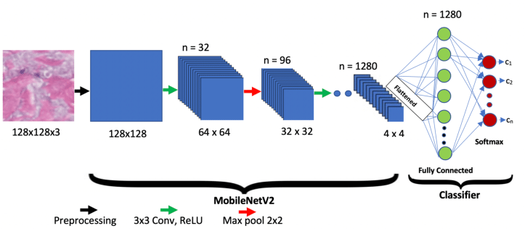
GOKARAJU RANGARAJU INSTITUTE OF ENGINEERING AND TECHNOLOGY
Department of Computer Science and Engineering
MINI Project Review-3
Mobilenetv2 is a model which does the same convolution as done by CNN to filter images but in a different way than those done by the previous CNN. It uses the idea of Depth convolution and point convolution which is different from the normal convolution as done by normal CNNs.
This increases the efficiency of CNN to predict images and hence they can be able to compete in the mobile systems as well.

Slide 5
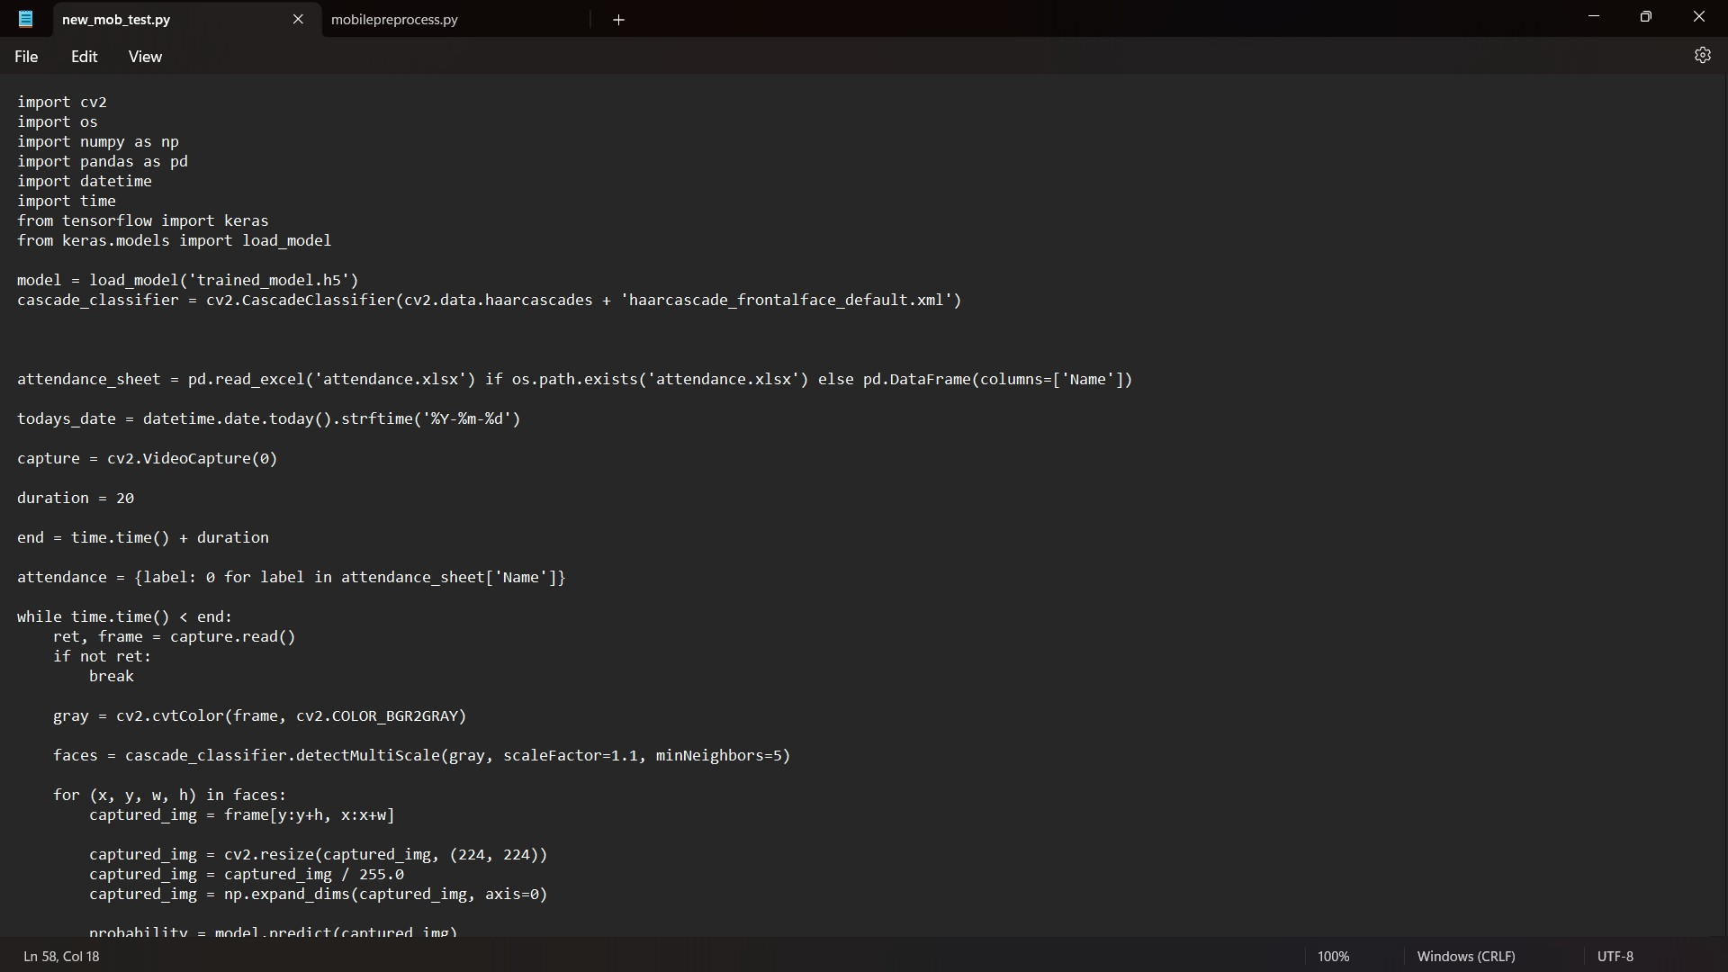
GOKARAJU RANGARAJU INSTITUTE OF ENGINEERING AND TECHNOLOGY
Department of Computer Science and Engineering
MINI Project Review-3
30-05-2023

Slide 6
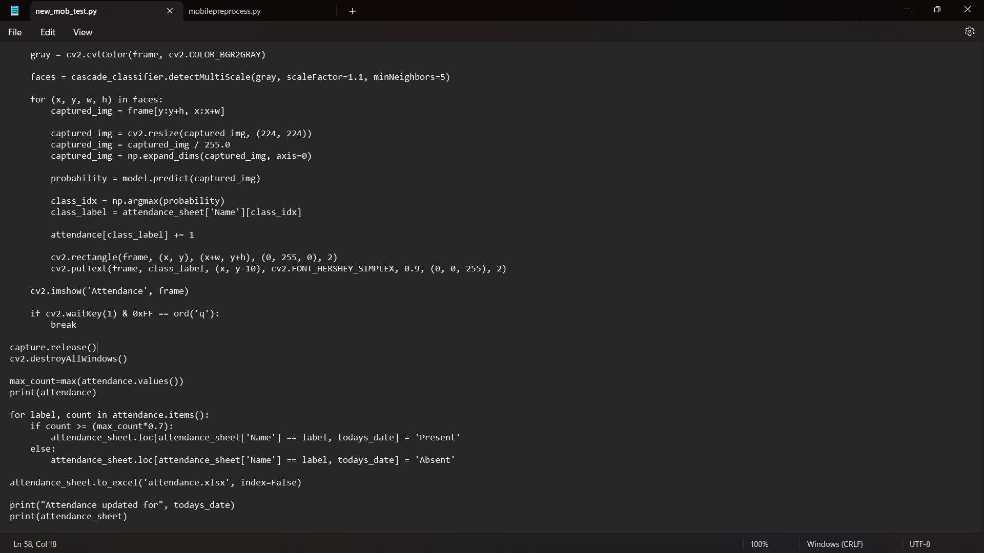
GOKARAJU RANGARAJU INSTITUTE OF ENGINEERING AND TECHNOLOGY
Department of Computer Science and Engineering
MINI Project Review-3

Slide 7
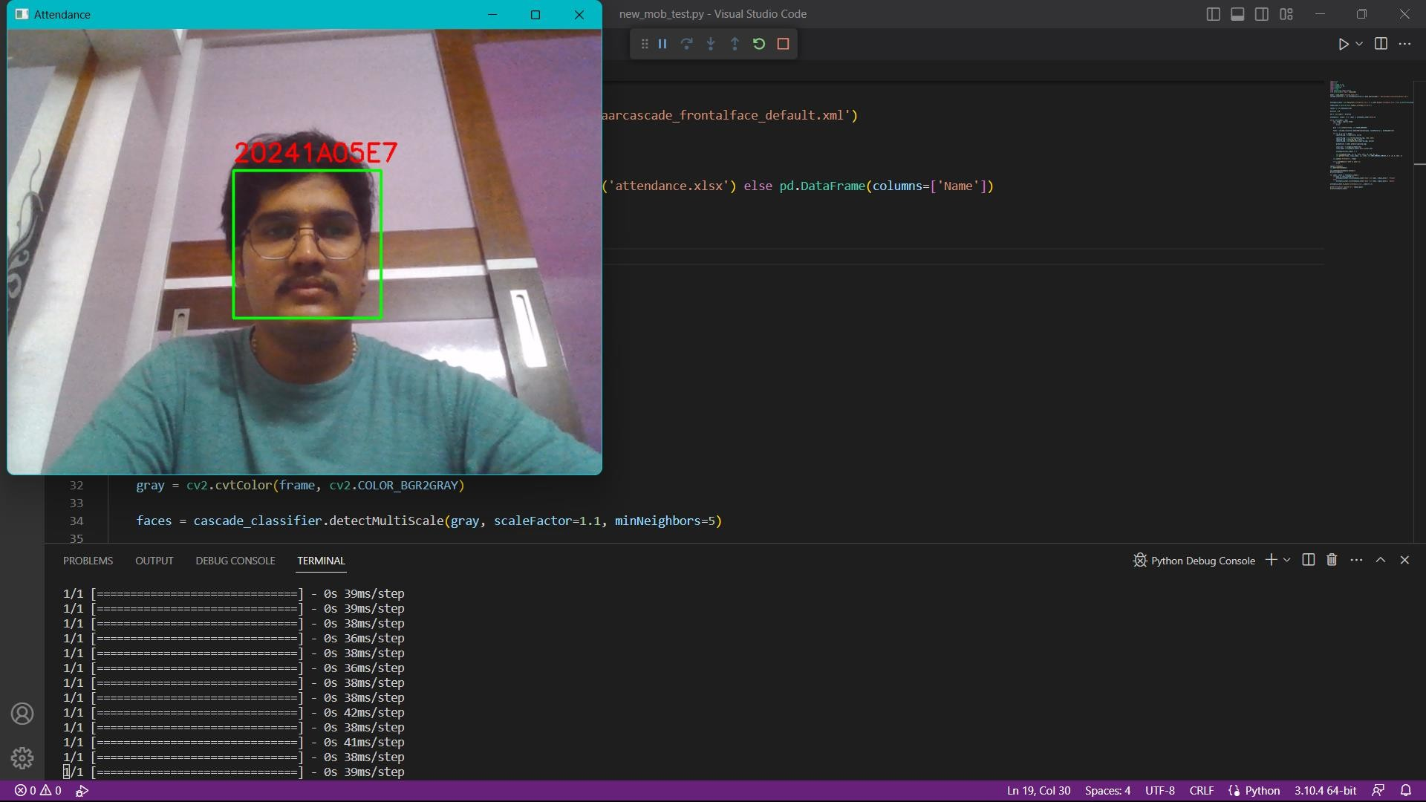
Department of Computer Science and Engineering
GOKARAJU RANGARAJU INSTITUTE OF ENGINEERING AND TECHNOLOGY
MINI Project Review-3
RESULTS:

Slide 8
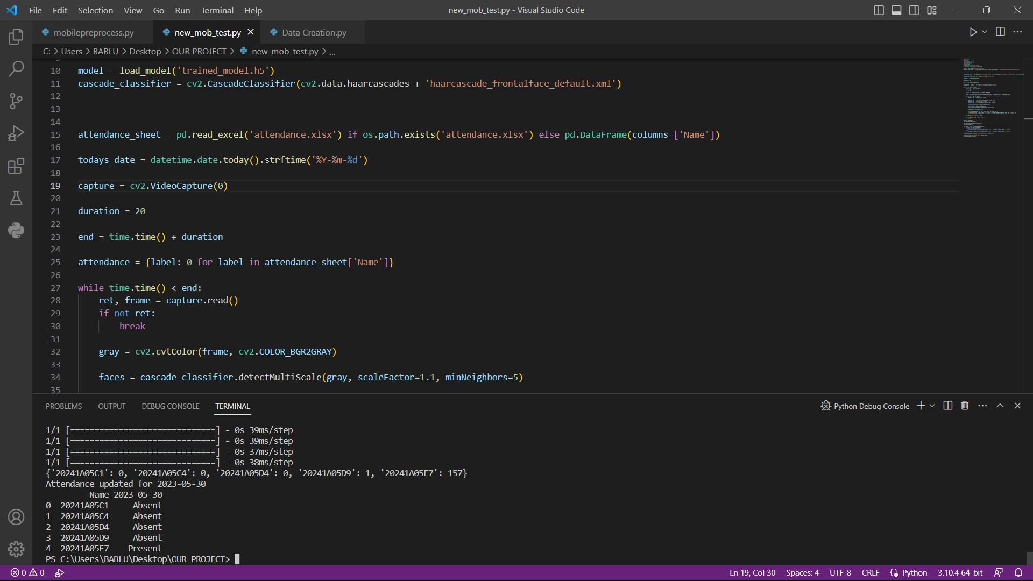
Department of Computer Science and Engineering
GOKARAJU RANGARAJU INSTITUTE OF ENGINEERING AND TECHNOLOGY
MINI Project Review-3
RESULTS:

Slide 9
GOKARAJU RANGARAJU INSTITUTE OF ENGINEERING AND TECHNOLOGY
Department of Computer Science and Engineering
MINI Project Review-3
Conclusion:
It streamlines the attendance process ,improves accuracy ,enhances convenience and strengthens security .
It's implementation benefit educational institutions ,and businesses by optimising attendance management and enabling more efficient resource allocation .
Scope:
The scope of smart attendance management can vary depending upon the specific requirements of an organization.
It can be implemented in various settings such as schools , universities, work places, or events, to efficiently manage attendance and enhance security.

Slide 10
GOKARAJU RANGARAJU INSTITUTE OF ENGINEERING AND TECHNOLOGY
Department of Computer Science and Engineering
MINI Project Review-3
THANK YOU & QUREY
30-05-2023

